Slide 1

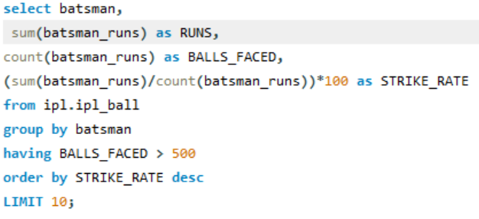
LIST OF 10 MOST AGGRESSIVE BATSMAN.
SQL QUERY FOR FINDING 10 MOST AGGRESSIVE BATSMAN
AGGRESSIVE BATSMAN HAVE BEEN CATEGORISED AS BATSMAN WHO HAD HIGH STRIKE RATE AND FACED AT LEAST 500 BALLS .

Slide 2
MOST AGGRESSIVE BATSMAN.

Slide 3
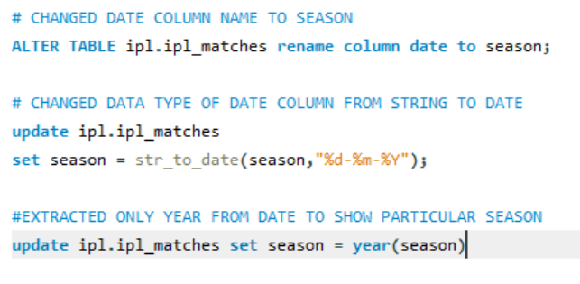
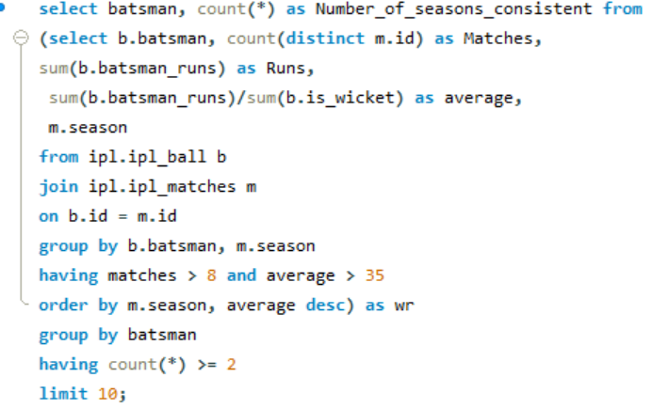
LIST OF 10 MOST CONSISTENT BATSMAN.
* CONSISTENT BATSMAN – ANY BATSMAN WHO HAVE PLAYED AT LEAST 8 MATCHES IN A SEASON, AVERAGE OVER 35 AND ATLEAST HAVE DONE THESE TWO THINGS IN 2 SEASONS.
Query to change data type of DATE column from string to date, so that to use it to take out different seasons.
Query to find most consistent batsman on the based on AVERAGE in particular season and count in how many season they have been consistent and take out the names of batsman according to max number of consistent season.

Slide 4
CONSISTENT BATSMAN

Slide 5
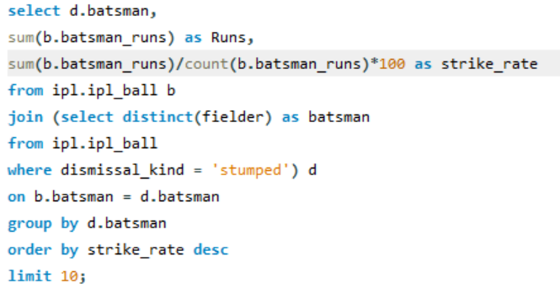
WICKETKEEPER
SQL Query for selecting WICKETKEEPER
WICKETKEEPER - In T20, the emphasis is on scoring runs quickly, so the wicketkeeper is often expected to contribute to the team's run total with aggressive batting.
So the filter applied to select the wicket keeper based on a good strike rate along with some runs.

Slide 6
WICKETKEEPER

Slide 7
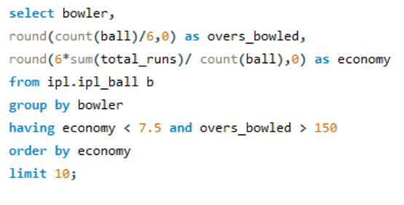
ECONOMICAL BOWLER
A bowler who gave less than 7 runs per over and had bowled at least 150 overs in IPL seasons so far will be considered as ECONOMICAL BOWLER.
SQL Query for finding top 10 economical bowler:-

Slide 8
ECONOMICAL BOWLERS

Slide 9
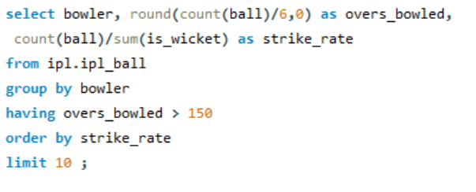
WICKET TAKING BOWLER
Wicket taking bowlers are those bowlers who constitutes low strike rates and at least 150 overs bowled

Slide 10
WICKET TAKING BOWLER

Slide 11
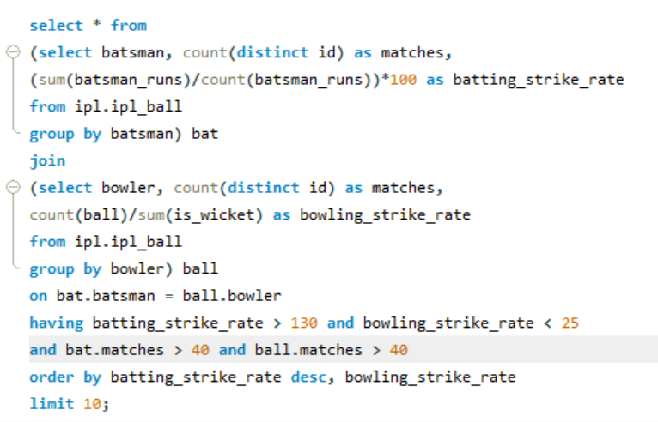
ALL ROUNDERS
Allrounders are the significant part of a team’s combination as they are specialised in more than one skill, hence provide stability to the team.
The filter to find out the all rounders from the given data was based on the strike rate of both the batsman as well as bowlers i.e., More than 130 for batsman and less than 25 for bowlers.

Slide 12
ALL ROUNDERS

Slide 13
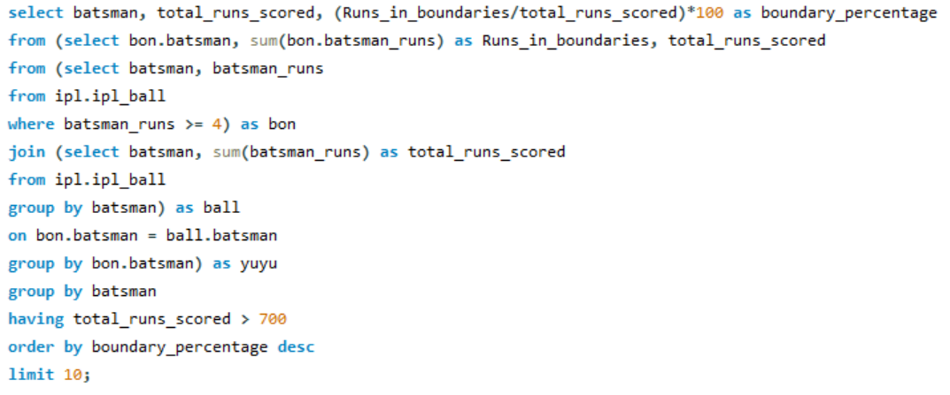
SQL QUERY TO FIND
HARD HITTERS

Slide 14
SQL QUERY TO FIND
HARD HITTERS
FILTERS FOR ALL-ROUNDER :-
Those player have been chosen who have higher boundary percentage.
Boundary percentage is calculated as follows –
(Runs scored in boundary /
Total runs scored ) * 100

Slide 15

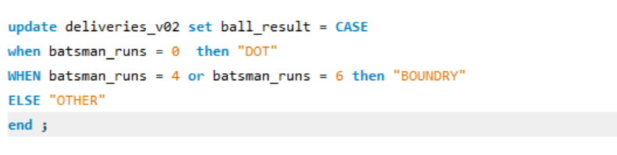
Additional Question For Final Assessment
1. Get the count of cities that have hosted an IPL match.
2. Create table deliveries_v02 with all the columns of the table ‘deliveries’ and an additional column ball_result containing values boundary, dot or other depending on the total_run (boundary for >= 4, dot for 0 and other for any other number) (Hint 1 : CASE WHEN statement is used to get condition based results) (Hint 2: To convert the output data of the select statement into a table, you can use a subquery. Create table table_name as [entire select statement].

Slide 16
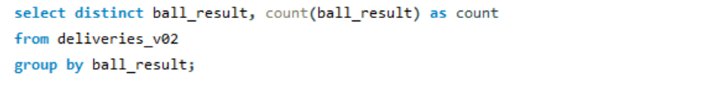
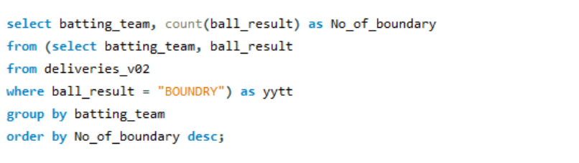
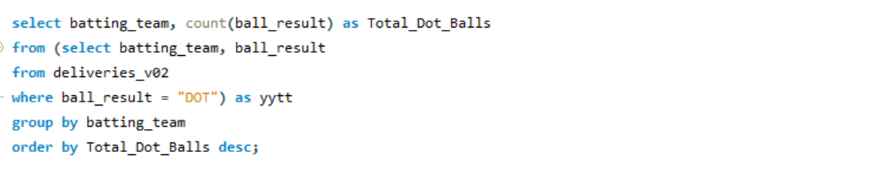
3. Write a query to fetch the total number of boundaries and dot balls from the deliveries_v02 table.
4. Write a query to fetch the total number of boundaries scored by each team from the deliveries_v02 table and order it in descending order of the number of boundaries scored.
5. Write a query to fetch the total number of dot balls bowled by each team and order it in descending order of the total number of dot balls bowled.

Slide 17
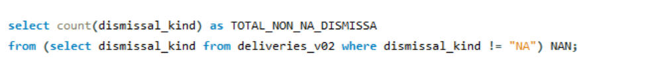
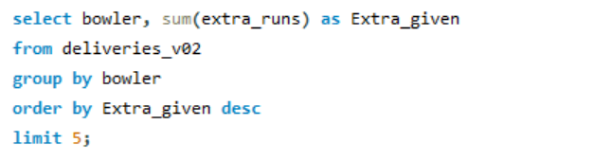
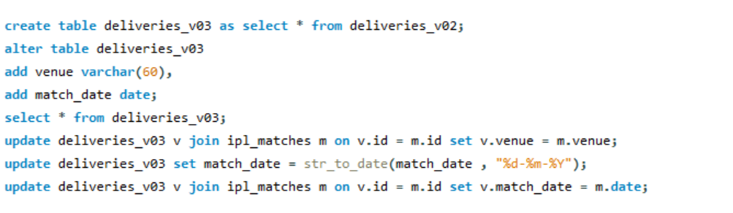
6. Write a query to fetch the total number of dismissals by dismissal kinds where dismissal kind is not NA
7. Write a query to get the top 5 bowlers who conceded maximum extra runs from the deliveries table
8. Write a query to create a table named deliveries_v03 with all the columns of deliveries_v02 table and two additional column (named venue and match_date) of venue and date from table matches

Slide 18
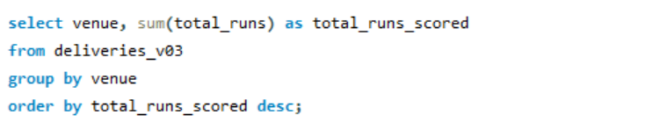
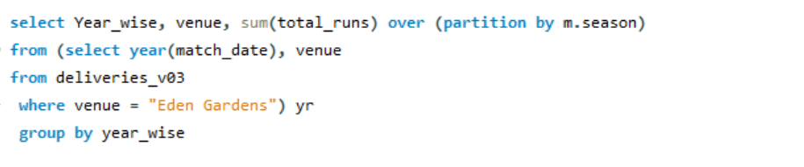
9. Write a query to fetch the total runs scored for each venue and order it in the descending order of total runs scored.
10. Write a query to fetch the year-wise total runs scored at Eden Gardens and order it in the descending order of total runs scored.

